Slide 1




A recommender system based on customer interaction with an e-commerce website
Richard Hruby (17-619-172)
Johan Faxner (21-603-204)
Tim Matheis (21-603-907)
Giovanni Magagnin (17-300-914)
Thursday, 12th of May 2022. Big Data Analytics (8,727,1.00)

Slide 2
Motivation
The number of digital buyers worldwide went from 1.32b in 2014 to 2.14b in 2021 (Statista)
The availability of information increases the importance of systematic data collection, data processing, data analysis and implementation in various business and value chains
Several studies (inter alia: Accenture, 2018; PwC, 2019; Deloitte, 2019) indicate consumers’ wish and demand for personalization
➔ How well can we predict the purchases of an online shopper based on their previous shopping behavior as well as the purchasing behavior of other customers?

Slide 3
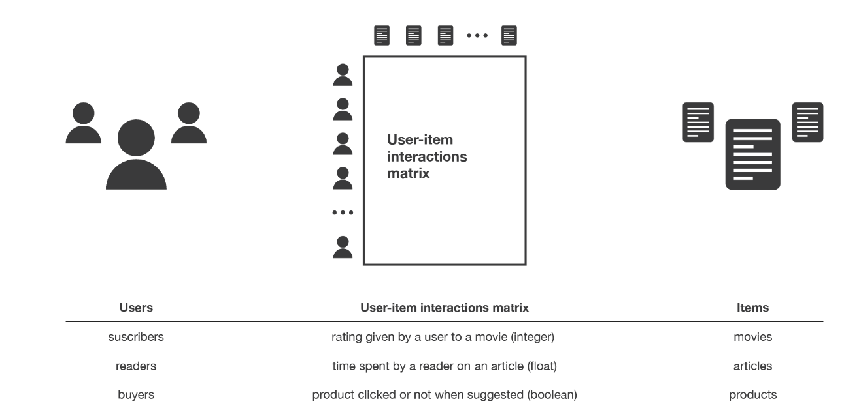
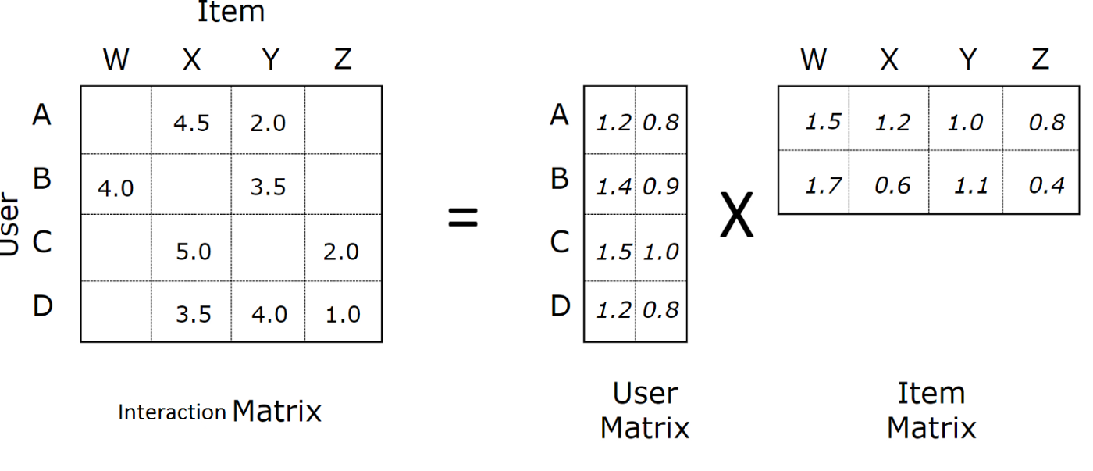
Methodology
Recommender system
Subclass of Information filtering Systems that seeks to predict the rating or the preference a user might give to an item.
Requirements:
A set of products and a set of customers who, in some way, have interacted with these products.
User-based collaborative filtering
Past users’ behaviour to generate future preferences
We discover the relevant features based on patterns
The features are not “human-based” they are the result of an algorithm.
Alternating least squares (ALS)
Suitable for larger-scale collaborative filtering problems
ALS minimizes two loss functions alternatively
ALS runs its gradient descent in parallel across multiple partitions of the training data

Slide 4
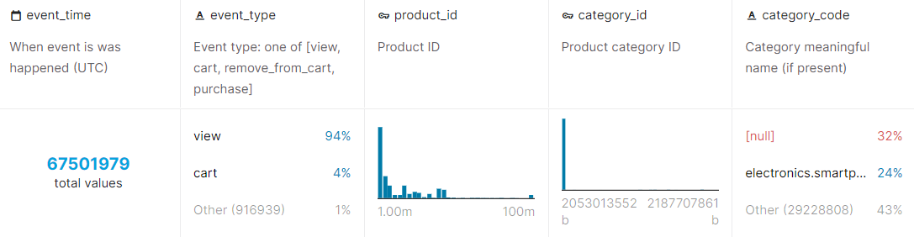
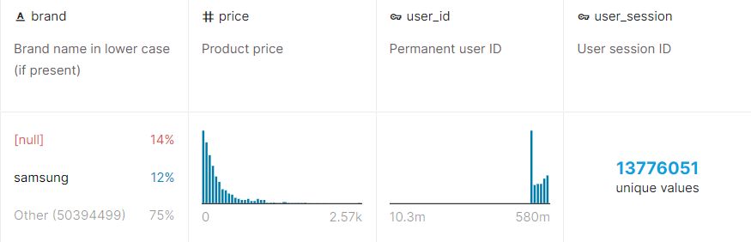
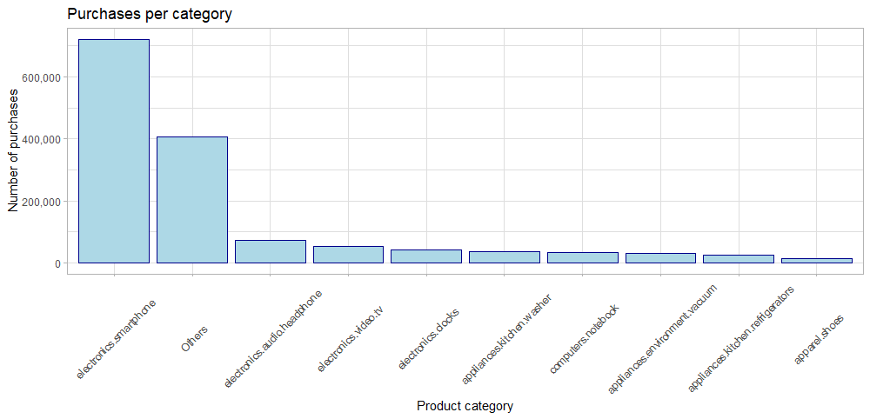
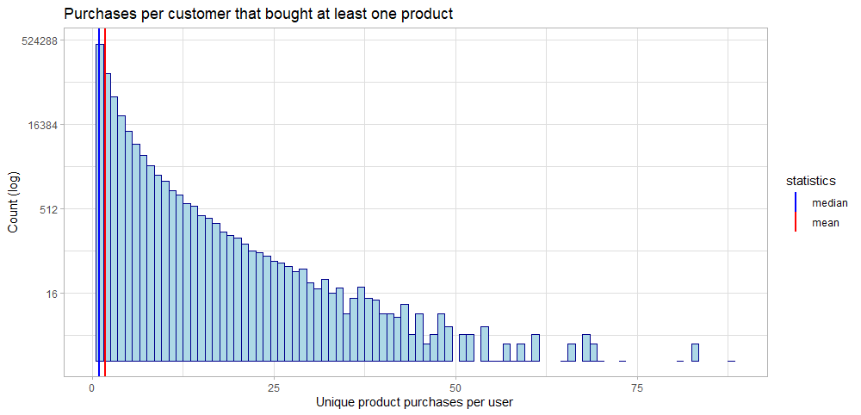
Data-set
We used a 15GB data-set with behaviour data for 2 months from a large multi-category online store from Kaggle. The data is organized in the following way:
10 categories make up the most purchases in the set. Smartphones and “others” account for most sales.
Most active customers that buy at least one product, also only buy one product.

Slide 5
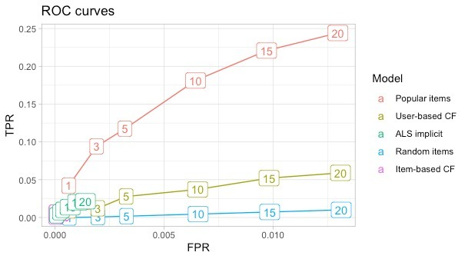
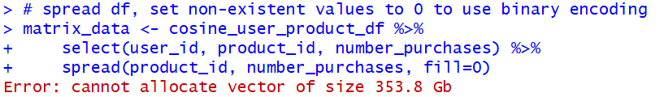
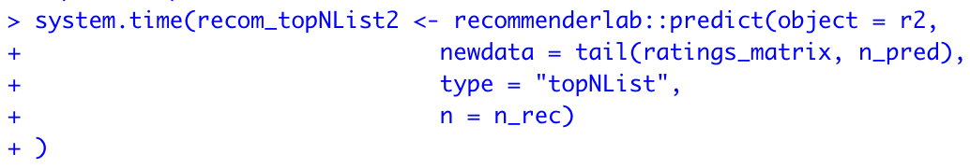
Implications of the big data set – Issues we faced while working with 15GB
Started with a subset of our data (200k rows):
We used recommenderlab, R package that provides an infrastructure to test and develop recommender algorithms
➔ With the reduced data-set of 200k rows, it worked fine
We tried the same approach with the entire data, but found 2 bottlenecks:
Bottleneck 1: User-item matrix grows exponentially
Bottleneck 2: Larger user-item matrix implies slower predictions
number of rows | memory usage
200k | 35 MB
400k | 124 MB
800k | 362 MB
number of rows | time elapsed
200k | 13.3 sec.
400k | 41.5 sec.
800k | 93.5 sec.

Slide 6


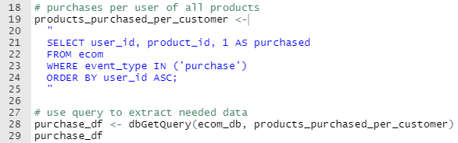
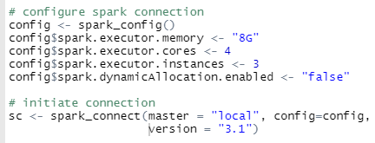
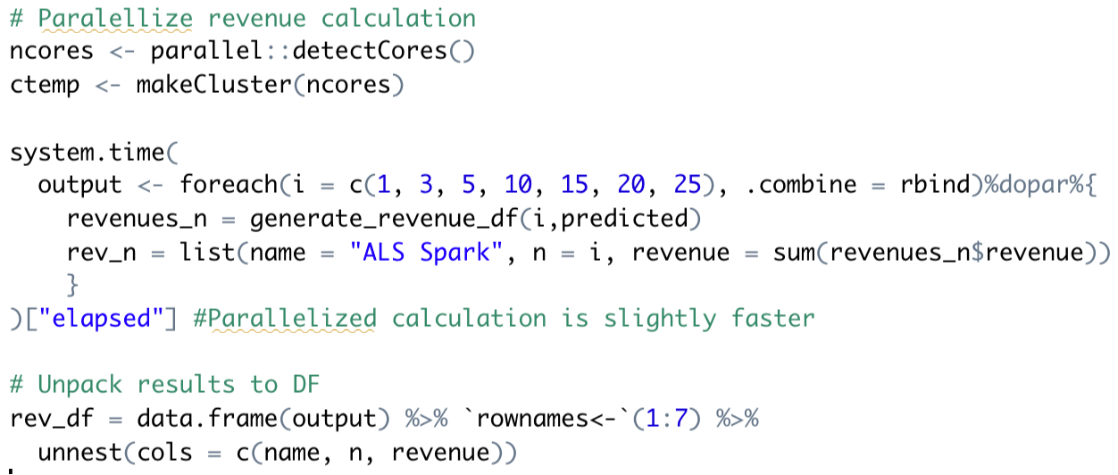



Big data techniques – How we solved the issues we were facing
/
Shift memory load from RAM to SDD
Split CSV file into tables in SQL
Enable to query important information
Distribute computationally expensive processes
Migrate pipeline to SparklyR
Enable scaling to the entire dataset
Speed up training and evaluation of recommender
Joins and parallelized loops
Enable efficient processing and real-time predictions

Slide 7
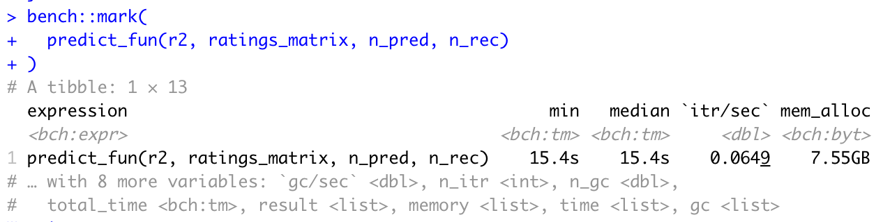
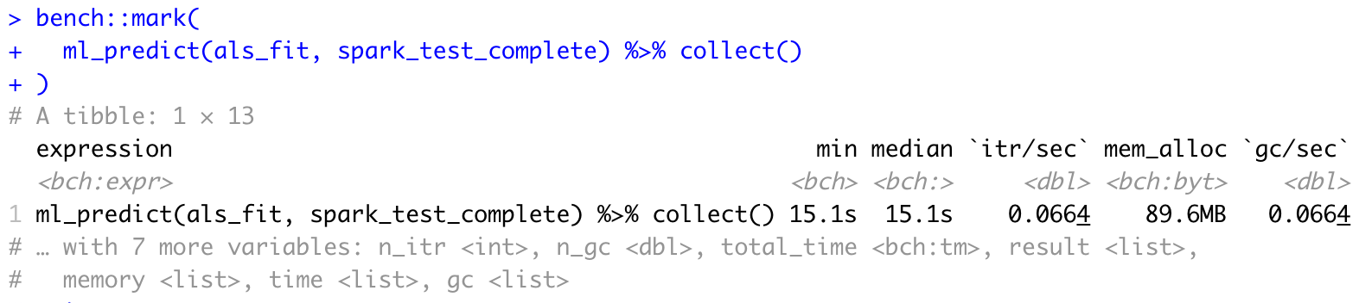
Performance of big data methods – Speed and efficiency improvements
Recommenderlab
Inefficient:
Small rating matrix size (2872 x 1523)
Slow prediction time: ~15 seconds for 1000 users
Large memory allocation: used entire RAM on laptop
Sparklyr
Efficient:
Large rating matrix size (48187 x 9015)
Same prediction time, but for a matrix 100 times the size.
Small memory allocation: negligible RAM required
It takes 15 seconds to generate the top 15 predictions for 1,000 users with recommenderlab on a 2872 x 1523 rating matrix.
Meanwhile, Spark allows us to generate 1,000 predictions in 8 seconds on a 48187 x 9015 rating matrix
Base R cannot handle spreading a user-item matrix of size 48187 x 9015, but Spark allows us to do it in only (no measure available) seconds
I'm not sure if I want to go into efficient coding here, because he pretty explicitly said to focus on the economic content, not coding, since this will be included in the final report anyway.

Slide 8
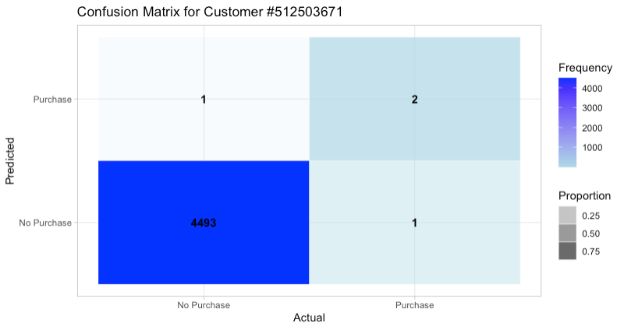
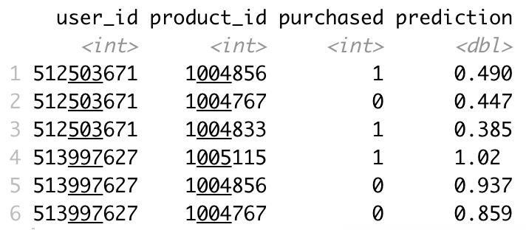
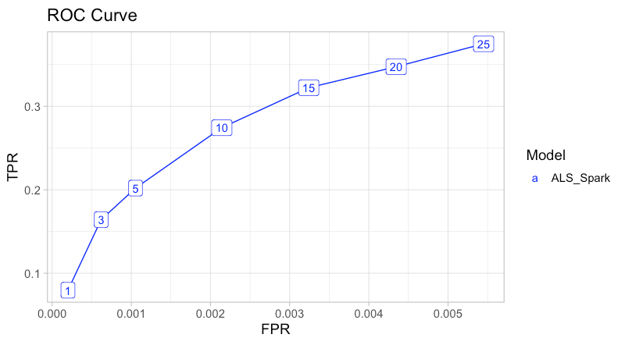
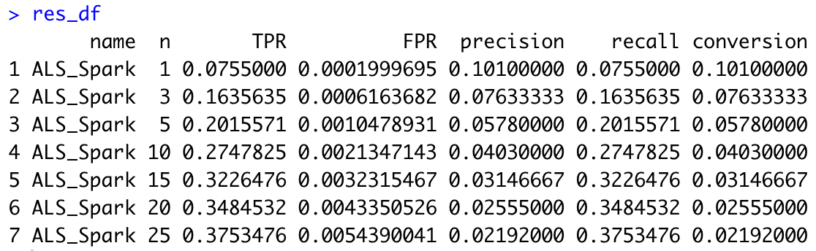
Results of the prediction – Our assesment
This customer purchased 2 out of 3 recommended products
1. Top-N predictions for 2 sample users
User 1
n = 3
User 2
2. Evaluation Metrics per User
With 15 recommendations we capture 1/3 of the products purchased
User 1
User 2
3. Average Evaluation Metrics for N 1:25
1000 users

Slide 9
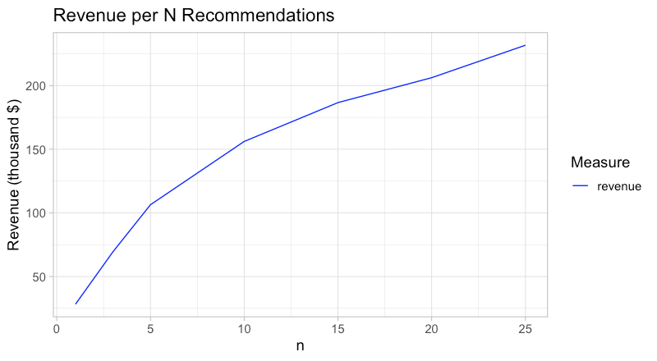
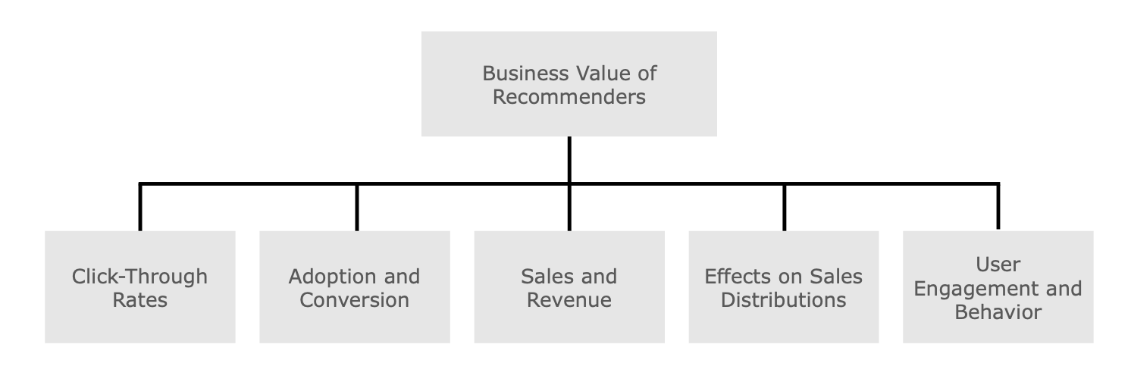
Business and economic implications
Business value
Real increase in revenues:
With n (recommendations x user) = 5, the business has a net increase of >100k USD
With n (recommendations x user) = 15, the business has a net increase of >200k USD
Economic implications
Positive welfare for sellers (Fleder and Hosanagar 2009):
Meeting the consumers’ individual preferences
Intensifying the users’ transactions and consumption time
Turning browsing consumers into buyers, cross selling, increasing customer loyalty
Positive welfare for buyers:
Transaction costs can be reduced, more precisely search costs
Solves the information overload problem
Source: Jannach & Jugovac (2019)

Slide 10


Limitations of our approach – What else could be done?
Limitations:
Backward looking bias: We test whether we would have recommended a product to a customer that actually bought this product. However, the «wrong» predictions could have also led to purchases when the product would have been recommended to the customer.
Methods: simplistic «market-basket analysis»
Limited data: only two months of data used for analysis
Product/Customer differentiation: We treat the products/customers as if they were equal. But it would be useful to include the characteristics of the products.
Future work:
Measure real-life business value: AB testing to figure out how well recommendations work
Customer behaviour: Including the other interactions of users for predictions (e.g. view, put in cart, and remove from cart)
Scaling up: AWS for more robust data pipeline and quicker computation
Hybrid recommender systems: Incorporate further information about products and users to increase relevance of recommendations

Slide 11
A recommender system based on customer interaction with an e-commerce website
Richard Hruby (17-619-172)
Johan Faxner (21-603-204)
Tim Matheis (21-603-907)
Giovanni Magagnin (17-300-914)
Thursday, 12° of May 2022. Big Data Analytics (8,727,1.00)

Slide 12
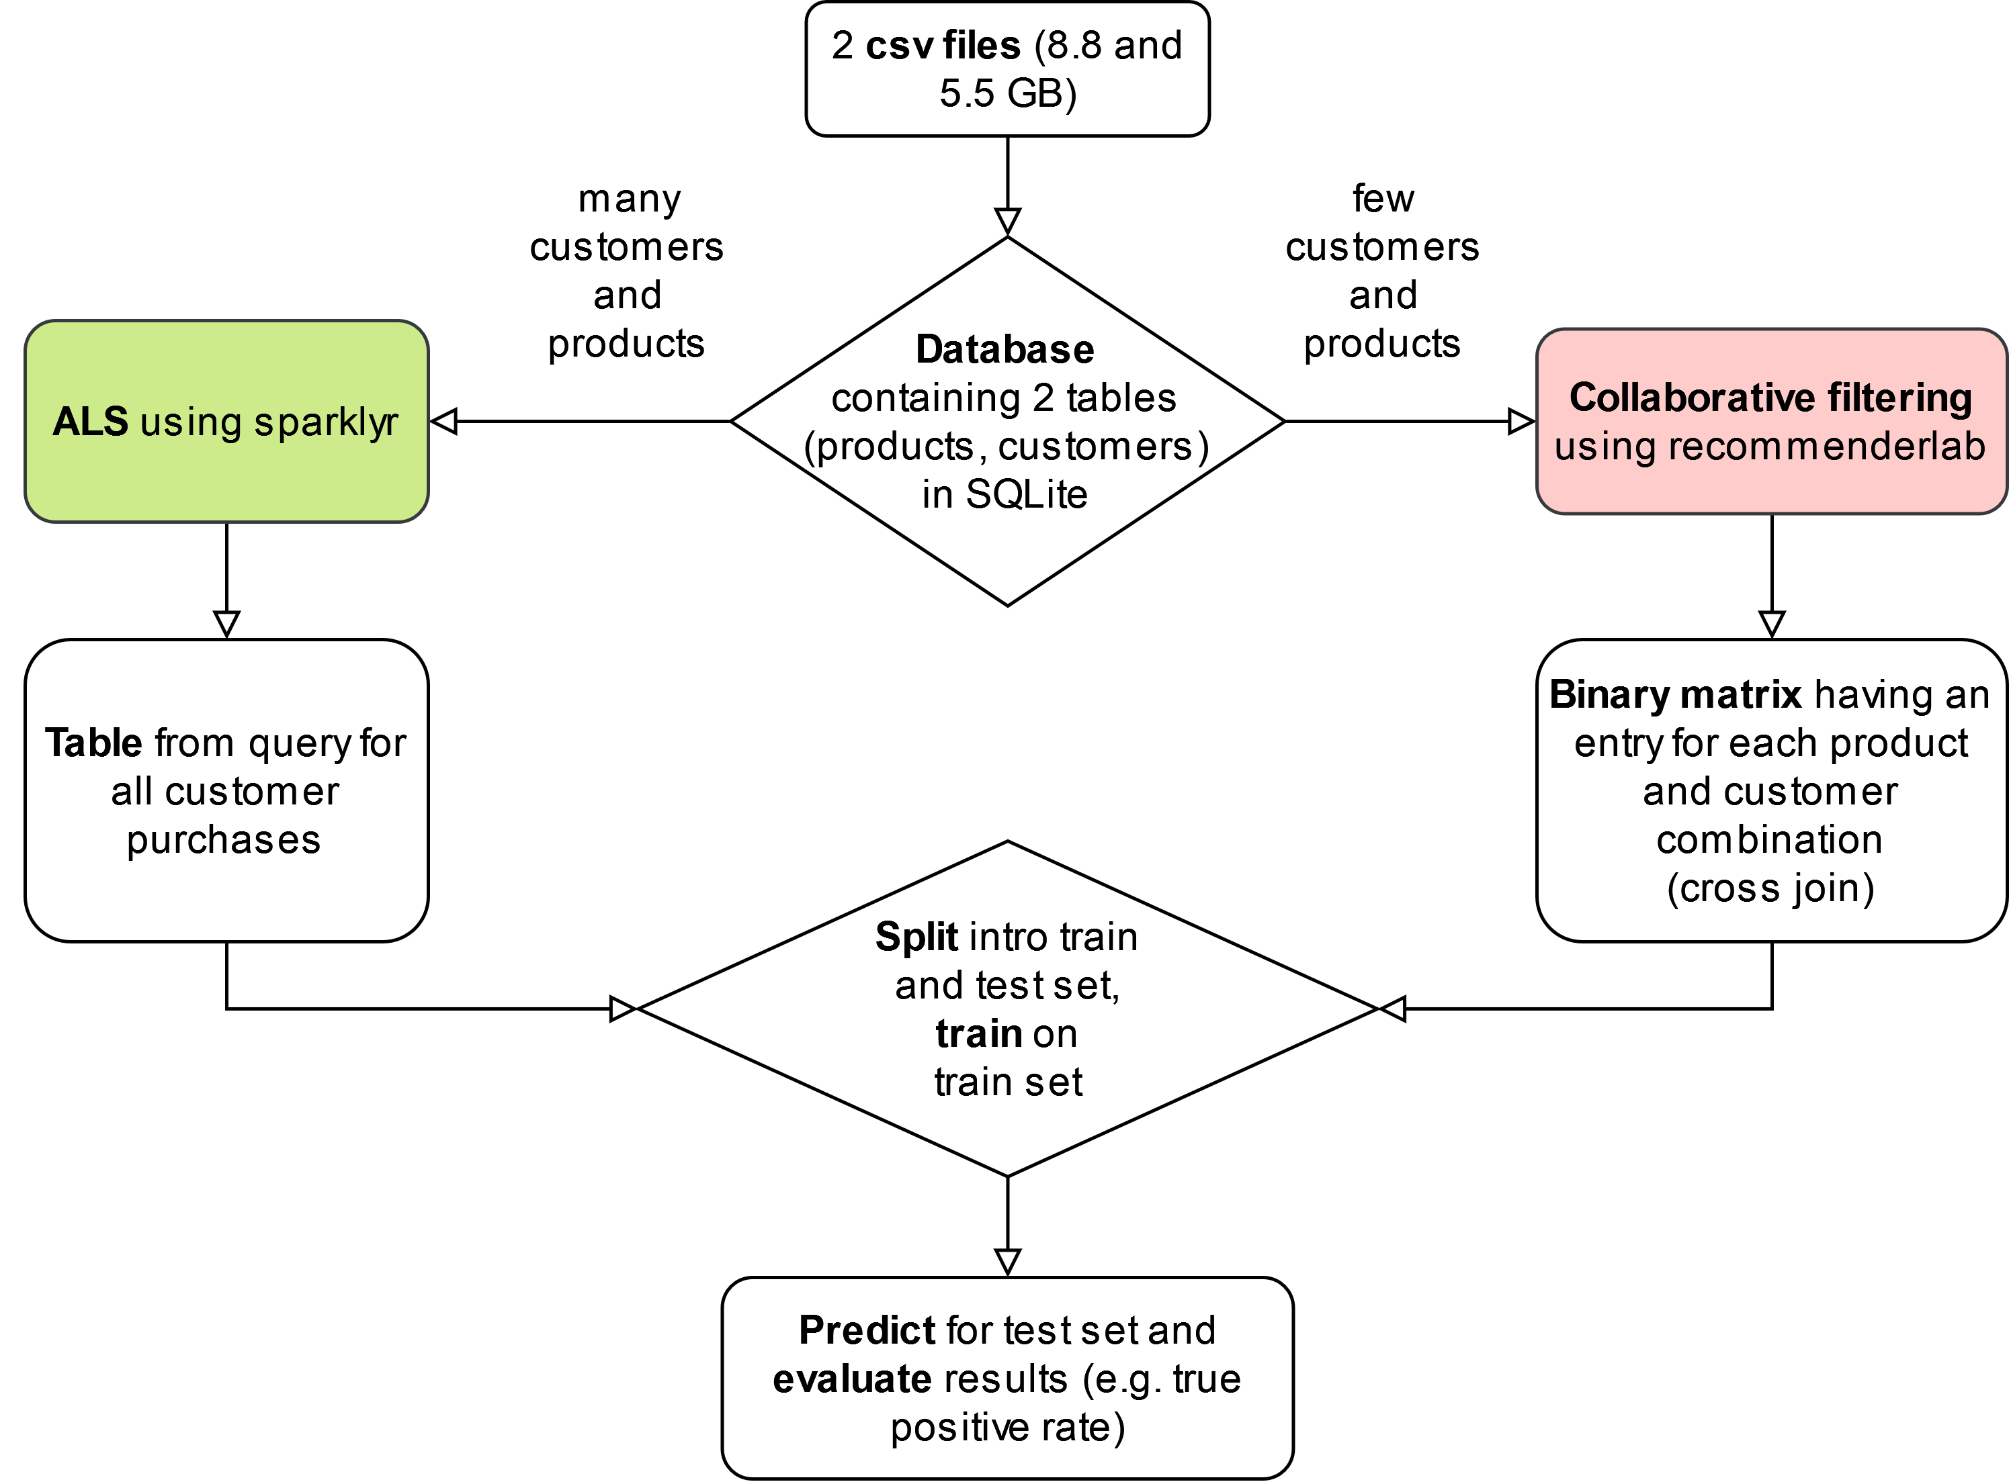
Discussion

Slide 13
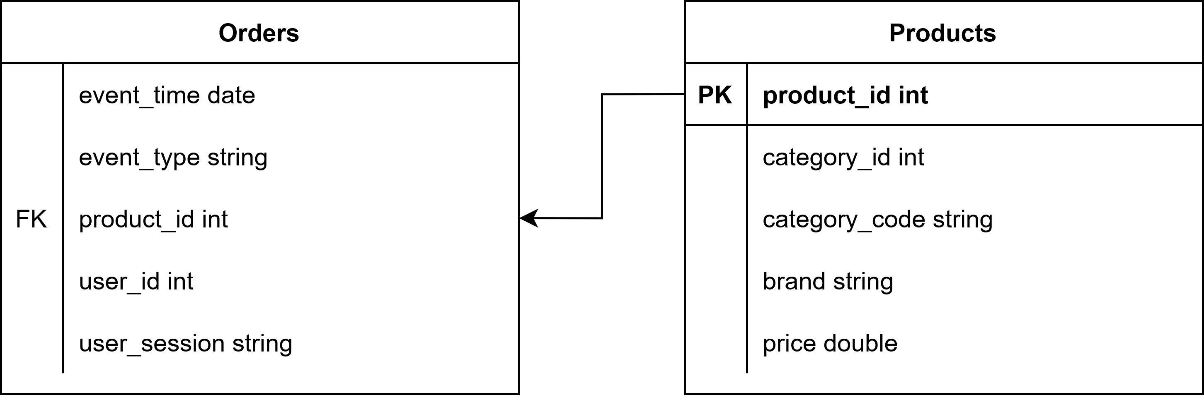
Appendix 1 - SQL

Slide 14
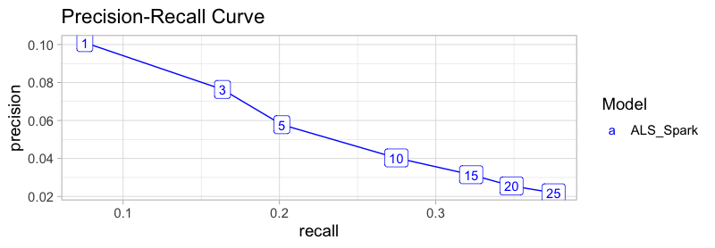
Appendix 2 – Precision Recall Curve

Slide 15
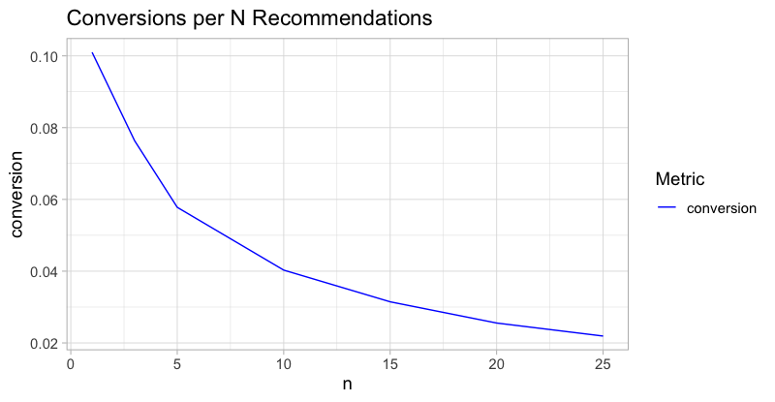
Appendix 3 – Conversions per N Recommendations

Slide 16
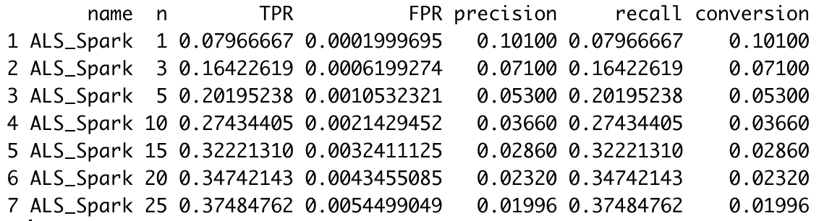
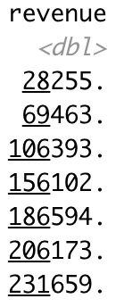

Appendix 3 – Top-N Evaluation N=1:25

Slide 17
References
https://gist.github.com/twolodzko/7becd98ff256ef826b56945de297700d
https://utd-ir.tdl.org/bitstream/handle/10735.1/5485/ETD-5608-7403.99.pdf?sequence=5&isAllowed=y
http://www.learconference2015.com/wp-content/uploads/2014/11/Calvano-slides.pdf
https://www.econstor.eu/bitstream/10419/228752/1/174515275X.pdf
https://towardsdatascience.com/introduction-to-recommender-systems-6c66cf15ada
https://towardsdatascience.com/prototyping-a-recommender-system-step-by-step-part-2-alternating-least-square-als-matrix-4a76c58714a1

Slide 18
Performance of the big data methods, speed/efficiency improvements
It takes 15 seconds to generate the top 15 predictions for 1,000 users with recommenderlab on a 2872 x 1523 rating matrix.
Meanwhile, Spark allows us to generate 1,000 predictions in 8 seconds on a 48187 x 9015 rating matrix
Base R cannot handle spreading a user-item matrix of size 48187 x 9015, but Spark allows us to do it quickly

